Slide 1
CS333
Design and Analysis of
Computer Algorithms
Professor Michal Cutler
Heaps, heapsort, priority queues

Slide 2
This class
Heaps
Heapsort
Priority queues

Slide 3
The Heap Data Structure

Slide 4
Overview
Usage of a heap
  Priority queue
  HeapSort
Definitions: height, depth, full binary tree, completely full binary tree, left complete trees
Definition of a heap
Methods of a heap

Slide 5
Priority Queue
A priority queue is a collection of zero or more items,
  associated with each item is a priority
Operations:
  insert a new item
  delete item with the highest
  priority
  find item with the highest priority

Slide 6
Worst case time complexity for heaps
Build heap with given n items - Θ(n)
Build heap dynamically O(nlgn)
insert() into a heap with n items -
O(lg n)
deleteMin() from a heap with n items-
O(lg n)
findMin() - Θ(1)

Slide 7
Depth of tree nodes
Depth of a node is:
If node is the root - 0
Otherwise - (depth of its parent + 1)
Depth of a tree is maximum depth of its leaves.
0
1
1
2
2
A tree of depth 2

Slide 8
Height of tree nodes
Height of a node is:
  If node is a leaf - 0
  Otherwise - (maximum height of its children +1)
Height of a tree is the height of the root.
2
1
0
0
0
A tree of height 2

Slide 9
A completely full binary tree
A completely full binary tree is a binary tree such that:
  All internal nodes have 2 children
  All leaves have the same depth d
The number of nodes is
n = 2^{d+1} - 1
7 = 2²⁺¹ - 1
A full binary tree of depth = height = 2

Slide 10
A Completely full binary tree - cont.
Number the nodes of a full binary tree of depth d:
The root at depth 0 is numbered - 0
The nodes at depth 1, …, d are numbered consecutively from left to right, in increasing depth.
0
1
2
3
4
5
6

Slide 11
A complete binary tree
A complete binary tree of depth d and n nodes is a binary tree such that its nodes would have the numbers 1, …, n in a full binary tree of depth d.
The number of nodes 2^{d}≤ n ≤ 2^{d+1} -1
All the nodes in the tree are left filled
Sometimes called nearly complete, or left complete
0
0
1
2
1
2
3
4
5
3
4
5
6

Slide 12
Height (depth) of a complete binary tree
Number of nodes n satisfy:
2^{h} ≤ n and (n + 1)≤ 2^{h+1}
Taking the log base 2 we get:
h ≤ lg n and lg(n + 1) ≤ h + 1 or
lg(n + 1)-1 ≤ h ≤ lg n
Since h is integer and
⎡lg(n + 1) -1 ⎤ = ⎣ lg n ⎦
      h = ⎡lg(n + 1)⎤ - 1= ⎣ lg n ⎦
Notes:
Proof
2^{k}<=n<2^{k+1}
So k<=lgn<k+1
And k=floor(lgn)
If we add 1 n we get
2^{k}<n+1<=2^{k+1}
And k<lg(n+1)<=k+1
Or k-1<lg(n+1)-1<=k
So ceiling (lg(n+1)-1)=k=floor(lgn)

Slide 13
Definition of a heap
A heap is a complete binary tree that satisfies the heap property.
Minimum Heap Property: The value stored at each node is less than or equal to the values stored at its children.
  OR Maximum Heap Property: greater

Slide 14
Heap and its (dynamic) array implementation
1
1
2
1
root = 0
Parent(i) =
= ⎣(i-1)/2⎦
Left(i)=2i+1
Right(i)=2i+2
3
2
3
4
5
6
8
7
29
6
7
8
9
18
14
9
last
bt
1
3
2
8
7
29
6
18
14
9
0
1
2
3
4
5
6
7
8
9

Slide 15
Methods
insert
deleteMin
percolateUp (or siftUp)
siftDown (Max-heapify in Cormen)
buildHeap
Other methods
  size, isEmpty, findMin, decreaseKey
Assume that bt is an array that is used to “store” the heap and is visible to all methods.

Slide 16
insert(v)
0
10
Item inserted as new last item in the heap
  Heap property may be violated
PercolateUp to restore heap property
2
1
30
20
3
4
5
6
80
70
29
6
last
Last
after
insert
6

Slide 17
PercolateUp
Start at index to Reestablish MinHeap Property
procedure percolateUp (index )
if index >root // root = 0
p = parent(index)
if bt [p].key > bt [ index ].key
swap( index, p)
percolateUp(p)
The worst case growth rate of percolate is Θ(d(index)) where d(index) denotes the depth of node index or O(lg n).

Slide 18
Time analysis for Percolate(index)
0
2
1
d
3
4
5
6
lg n
O(d(index))
n-1
O(lg n)

Slide 19
insert(v)
insert( v )
last =last+1
bt[last] ← v //insert at new last position of tree
3. percolate ( last )
Time of insert is O(d(last)), or O(lg n)

Slide 20
percolateUp(last)
0
0
6
10
2
2
1
1
30
10
30
6
3
6
3
6
4
5
4
5
80
70
29
20
80
70
29
20
last
last

Slide 21
deleteMin()
0
10
10
Save root object Θ(1)
Remove last element and store in root Θ(1)
siftDown(0)
1
2
30
20
3
80
0
last
80
1
2
30
20
0
After siftDown(0)
20
1
2
30
80

Slide 22
Delete minimum
deleteMin ()
1. minKeyItem = bt [root] //root = 0
2. swap(root, last)
3. last = last - 1 // decrease last by 1
4. if (last >0) // at least 2 elements
5. siftDown(root)
6. return minKeyItem
Worst case time is dominated by time for siftDown(root) is Θ(h(root)) or O(lg n). h(root) denotes the height of the tree

Slide 23
SiftDown(bt, i)
lC = Left[i]
rC = Right[i]
smallest = i
//smallest = index of min{bt[i], bt[lC], bt[rC]}
if (lC <= last) and (bt[lC] < bt[i])
smallest = lC
if (rC <= last) and (bt[rC] < bt[smallest])
smallest = rC
if (smallest != i) // Otherwise bt is already a heap
swap bt[i] and bt[smallest]
SiftDown(bt, smallest) //Continue to sift down

Slide 24
Time analysis for Siftdown(i)
0
O(lg n)
2
1
3
4
5
6
lg n
h
O(h(i))
n-1

Slide 25
0
siftDown(0)
New value at root.
9
Right Child is smaller
Exchange root and right child
2
1
4
3
3
4
5
6
8
17
6
13
7
8
9
12
14
19
Satisfy the Heap property.

Slide 26
0
3
2
1
4
9
Parent
Left Child is smaller
Exchange parent and left child
3
4
5
6
8
17
6
13
7
8
9
12
14
19

Slide 27
0
3
2
1
4
6
3
4
5
6
8
17
9
13
7
8
9
12
14
19
The worst case run time to do siftDown(index) is
Θ(h(index)) where h(index) is the height of node index
or O(lg n)

Slide 28
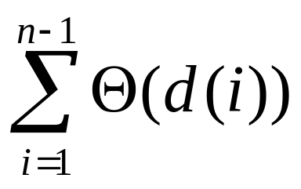
Building a Heap: Method 1
Assume that array bt has n elements, and needs to be converted into a heap.
slow-make-heap() {
  for i ← 1 to last do
  percolateUp ( i )
  }
  The worst case time is
  Note: An alternative for percolate is to use here insert. This will be the case when elements are added dynamically

Slide 29
Percolate(1) 1 swap
Percolate(2) 1 swap
0
0
10
9
2
2
1
1
9
8
3
6
10
8
4
5
3
6
4
5
7
6
5
4
7
6
5
4
7
8
9
7
8
9
3
2
1
3
2
1

Slide 30
Percolate(3) 2 swaps
Percolate(4) 2 swaps
0
0
8
7
2
2
1
1
10
9
3
6
8
9
4
5
3
6
4
5
7
6
5
4
10
6
5
4
7
8
9
7
8
9
3
2
1
3
2
1

Slide 31
Percolate(5) 2 swaps
Percolate(6) 2 swaps
0
0
6
5
2
2
1
1
7
9
3
6
7
6
4
5
3
6
4
5
10
8
5
4
10
8
9
4
7
8
9
7
8
9
3
2
1
3
2
1

Slide 32
Percolate(7) 3 swaps
Percolate(8) 3 swaps
0
0
4
3
2
2
1
1
7
5
3
6
4
5
4
5
3
6
4
5
10
8
9
6
7
8
9
6
7
8
9
7
8
9
3
2
1
10
2
1

Slide 33
Percolate(9) 3 swaps
The heap
0
0
2
1
2
2
1
1
3
5
3
6
2
5
4
5
3
6
4
5
4
8
9
6
4
3
9
6
7
8
9
7
8
9
10
7
1
10
7
8

Slide 34
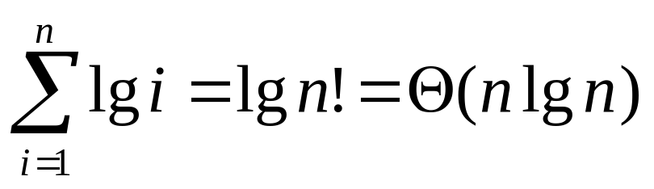
Time for slow make heap
The depth of node i for a current heap with i nodes is ⎣lg i⎦.
For simplicity we assume that the time of percolate is lg i .
So worst case time of slow make heap is

Slide 35
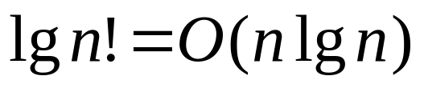
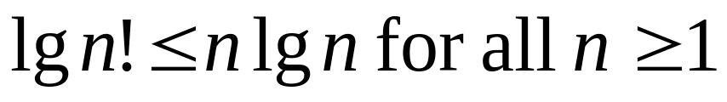
Why?
n! = n*(n-1)*(n-2)*…*3* 2 *1 <= n*n*n*…*n* n *n =n^{n}
So lg n! <= lg n^{n} = n lg n for all n >= 1
To show BigOh. We choose a c = 1 and N=1. Clearly,

Slide 36
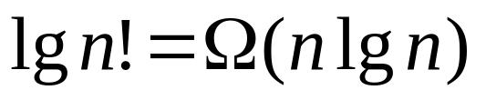
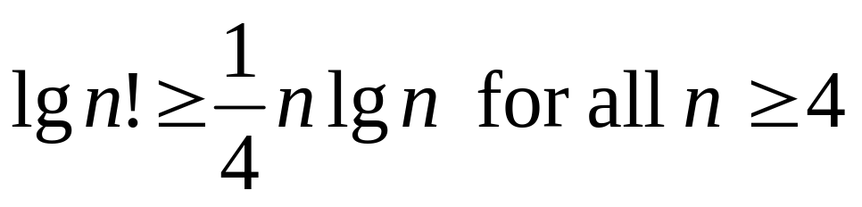
Why?
n! = n*(n-1)*…⎣n/2⎦*…*2 *1 >= n/2*n/2*n/2*…*n/2 =
= (n/2)^{n/2} for all n>=1. (We neglect floors)
So lg n! >= lg (n/2)^{n/2} = n/2(lg n – 1) = 1/2(nlg n) – n/2 = ¼(nlgn) + (1/4(nlgn) – n/2) >= ¼(nlgn) provided that
¼(nlgn) – n/2 >= 0
Dividing by n>0 we get ¼(lg n) >= 1/2 and lg n >=2.
So n >= 4
To show Omega. We choose c = 1/4 and N=4. Clearly,

Slide 37
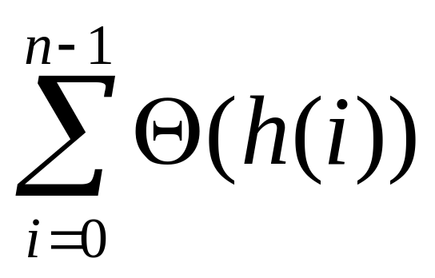
Build the Heap:Method 2
make-heap //- done in constructor.
1. for i ← last downto 0
2. do siftDown( i )
The worst case time is
Note that here the time to do siftDown(i) ≠lg i

Slide 38
5
8
12
9
7
10
21
6
14
4
0
1
2
3
4
5
6
7
8
9
0
5
2
1
8
12
3
4
5
6
9
7
10
21
7
8
9
6
14
4
siftDown(4) makes it a min heap
1 swap

Slide 39
i = 3
0
5
2
1
8
12
3
4
5
6
9
4
10
21
7
8
9
6
14
7
this is a heap
siftDown(3) makes this into heap
1 swap

Slide 40
0
5
i = 2
2
1
8
12
3
4
5
6
6
4
10
21
7
8
9
9
14
7
siftDown(2) 1 swap
makes heap
These are heaps

Slide 41
0
5
Siftdown(1)
2 swaps
2
1
8
10
3
4
5
6
6
4
12
21
After second
7
8
9
9
14
7
After first
1
1
4
4
3
4
siftDown
3
6
4
7
6
8
7
8
9
7
8
9
9
14
8
9
14
7

Slide 42
0
Siftdown(0)
1 swap
5
2
1
4
10
3
4
5
6
6
7
12
21
0
7
8
9
4
9
14
8
2
1
5
10
3
4
5
6
6
7
12
21
7
8
9
9
14
8

Slide 43
Example
The following slide shows an example of a worst case computation done by slow-make-heap, and fast make- heap
The heap contains 7000 nodes
The height is 12
73% of the nodes are in the bottom 3 levels of the tree
slow-make-heap requires 75822 swaps in the worst case, and an average of 11.3 swaps for 73% of the nodes (~10 for 100%)
Fast make-heap requires <8178 swaps in the worst case, and an average of .68 swaps for 73% of the nodes (~1.1 for 100%)

Slide 44
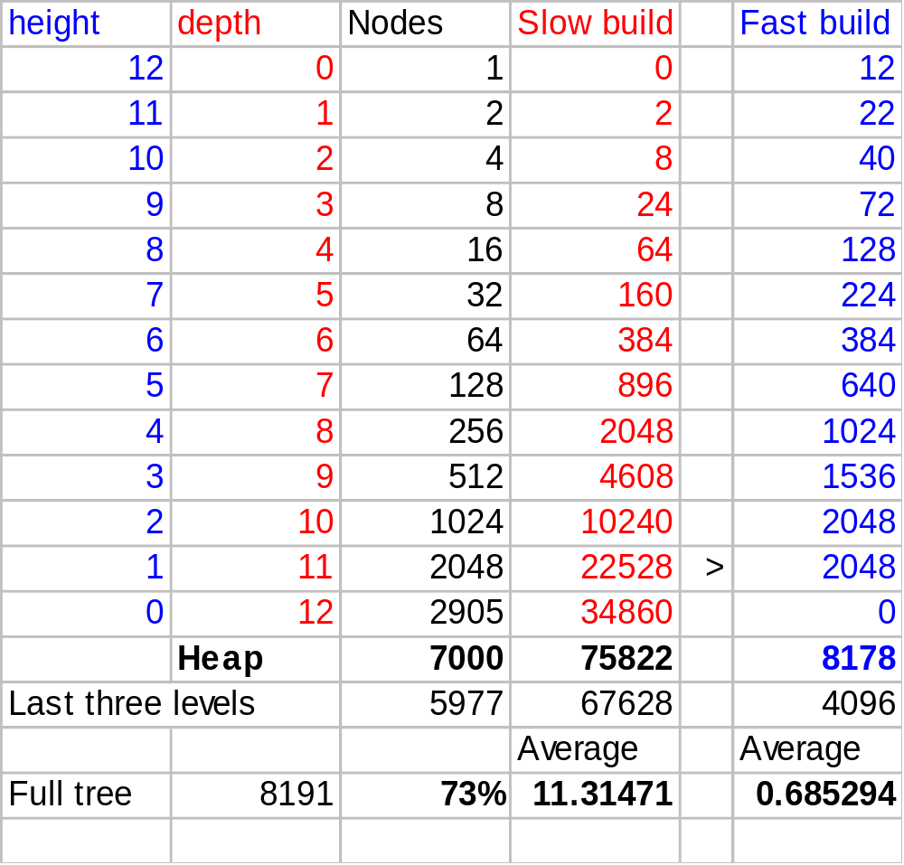

Slide 45
Tight analysis of Method 2
Notice we are building the heap “bottom up” .
Lot of work done for about for the few nodes with large heights (low depth)
Little work done for about ¾ of nodes.
height h
height h-1
height 1
height 0
height 0
“path” of
siftDowns

Slide 46
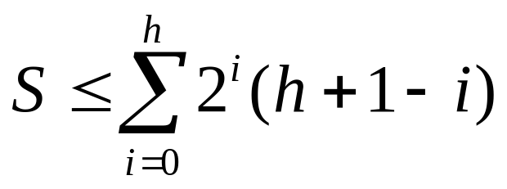
Cost of fast make heap
Depth
Number
Nodes Sift Count
1 h+1-0 2⁰( h+1)
2 h+1-1 2¹ h
4 h +1-2 2² (h -1)
8 h+1-3 2³ (h -2)
. . . . .
2^{i} (h+1- i) 2^{i} (h+1 -i)
. . . . .
2^{h-1} ≤ (h+1-(h-1)) ...
≤ 2^{h} 1 ≤ 2^{h}(1)
0
1
2
h-1
h
. . . . . . . . . . . . . . . . . . . . . .

Slide 47
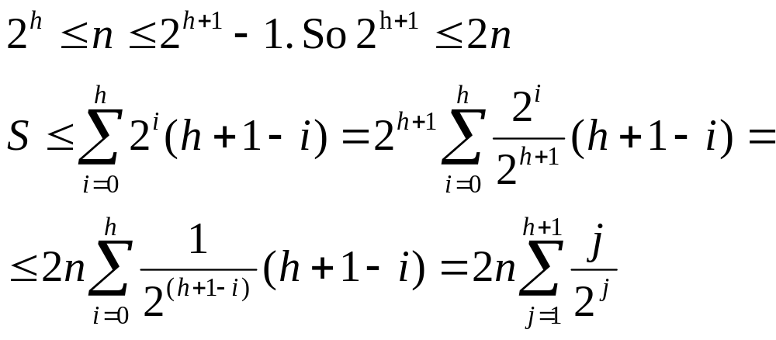
The total cost

Slide 48
∞
1)
∑
x ^{i}
=
1
(1-x )
for x < 1
Basic Geometric Progression
i = 0
∞
2)
∑
i x ^{i-1}
=
(-1)∗( -1)
(1-x ) ²
1
(1-x ) ²
=
Derivative of (1)
i = 1
∞
3)
∑
i x ^{i}
=
x
(1-x ) ²
Multiply (2) by x
i = 1
∞
4)
∑
i (1/2) ^{i}
1/2
(1-(1/2)) ²
2
=
=
Substitute x=1/2 in (3)
i = 1
h+1
∞
Therefore
∑
i
2 ^{i}
<
∑
i
2 ^{i}
=
2
i = 1
i = 1
We get the total cost S< 4*n = O ( n )

Slide 49
Improved Build the Heap:Method 2
make-heap //- done in constructor.
1. for i ← (n/2-1) downto 0
2. do siftDown( i )
The next foil explains that we can start siftDown at (n/2-1), because we :
  need to siftDown only parents
  the rest of the nodes are leaves and leaves satisfy the heap property
  There are at most n/2 parents stored in bt[0..n/2-1]

Slide 50
Leaves and “parents” in a Complete Binary Tree
_/P2
We show:
(n-1)/2 ≤ #parents ≤ n/2,
(n+1)/2 ≥ # leaves ≥ n/2
1) Number of 'C' = n-1
2) Number of 'P' = #P2 + #P1
3) Number of 'C' = 2 #P2 + #P1
From 1 and 3:
4) n-1 = 2 ∗ #P2 + 1 ∗ #P1
C/P2
C/P2
C/P2
C/P1
C/_
C/_
C/_
C/_
C/_
Case A: every parent has 2 children
#P1 = 0
#P2 = (n -1) / 2 from 4
#P = 0 + (n -1) / 2= (n -1) / 2
Case B: 1 parent has only 1 child
#P1 = 1
#P2 = (n -2) / 2 from 4
#P = 1 + (n -2) / 2 = n/2

Slide 51
HEAPSORT(A)
1. fast-build-Maxheap(A) //max heap if in-place
2. for i = last downto 1
3. swap A[i] and A[0]
4. last = last –1
5. siftDown(0)
Analysis: Lines 2-5 are O(nlg n) (line 1 is O(n))
Is heapsort stable? 2a,2b, 2c

Slide 52
DECREASE-KEY(bt, i, key) for minheap
if key < bt[i]
bt[i] = key
percolateUp(i)
else
print error “new key is larger or equal”

Slide 53
Abstract Data Type: Priority Queue
A priority queue is a collection of zero or more items,
  associated with each item is a priority
A priority queue has at least three operations
  insert(item i) (enqueue) a new item
  delete() (dequeue) the member with the highest
  priority
  find() the item with the highest priority
Note that in a priority queue "first in first out" does not apply in general.

Slide 54
Priority Queues: Assumptions
The highest priority can be either the minimum value of all the items, or the maximum.
  We will assume the highest priority is the minimum.
  Call the delete operation deleteMin().
  Call the find operation findMin().
Assume the priority queue has n members

Slide 55
Implementations
Heap.
  In the worst case:
  insert() is Θ(lg n) and
  deleteMin() is Θ(lg n)
  findMin() is Θ(1)
1,x
3,e
2,k
8,d
7,i
9,z

Slide 56
Unsorted list: Array
1. Using an array arr.
  insert() adds the new item into next empty position in arr, in Θ(1).
  findMin() is Θ(n) in the worst case
  deleteMin() is Θ(n) in the worst case
    Θ(n) to find the minimum item in worst case
    and Θ (1) to move the last item to the position of the deleted element.
  DecreasePriority(i, p) – decrease priority of ith item stored at arr[i-1] in Θ(1)
4,x
8,a
1,b
9,c
7,y
0
1
2
3
4
5

Slide 57
Unsorted list: Linked List
2. Using a linked list.
  insert() in Θ(1) with appropriate pointers.
  findMin() is Θ(n) in the worst case since we may need to search the whole list.
  deleteMin() is Θ(n)
    In the worst case we may need to search the whole list, Θ(n)
    Delete item, Θ(1)

Slide 58
Sorted list: Circular Array
1. A circular array A.
  insert() must maintain a sorted list.
    Θ(n) in the worst case
    For example:
    The new item needs to be inserted after the item with the highest priority.
    So n-1 items have to be moved to make room.
  findMin() is Θ(1)
  deleteMin() is Θ(1) because the minimum item is the first one in the queue, and only the pointer to the first item needs to be changed.
  DecreasePriority(i, p) – decrease priority of ith item, and reinsert Θ(n)
9,x
0,b
4,c
7,y
0
1
2
3
4
first

Slide 59
Sorted list: Linked List
2. A linked list.
  insert() is Θ(n)
    since in the worst case the whole list must be searched sequentially to find the location for insertion.
  findMin() is Θ(1)
  deleteMin is Θ(1)
  since with appropriate pointers the first element of a linked list can be deleted in Θ(1)

